Slide 1
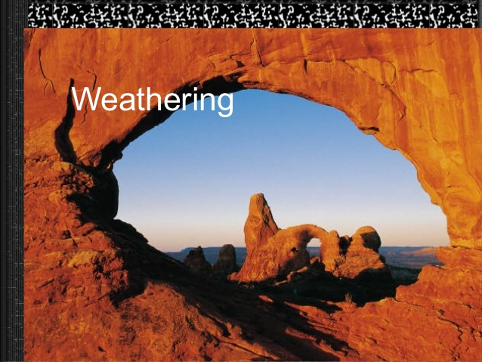
LEC : 5
Weathering – Types of weathering – Physical weathering of rocks – Agents of physical weathering and their role-Biological weathering – Role of flora and fauna in weathering process.

Slide 2
Weathering: is the process of Physical disintegration and chemical decomposition of rocks and minerals, resulting in the formation of parent material or Regolith
It is basically a combination of transformation and synthesis
Types of Weathering
Physical / Mechanical Weathering (Disintegration)
Chemical Weathering (Decomposition)
Biological Weathering (Disintegration and decomposition)

Slide 3
The breakdown of rocks into smaller
fragments is called weathering.
There are three types of weathering:
Physical/Mechanical weathering
Chemical weathering
Biological weathering

Slide 4
Physical/Mechanical weathering:
Physical weathering is a mechanical process, causing disintegration of consolidated massive rocks in to smaller pieces.
no change in chemical composition-just disintegration into smaller pieces
Agents for Physical weathering
Physical condition of rock
Temperature
Water
Ice
Wind
Atmospheric electric phenomena

Slide 5
Physical/Mechanical weathering:
Agents for Physical weathering
Physical condition of rock:
The permeability of rock is probably the most important single factor which determines the rate at which the rocks weather Ex:- Coarse textured sand stone (porous) weathers more rapidly than a fine textured (almost solid) basalt.
Basalt weathers rapidly than Granite

Slide 6
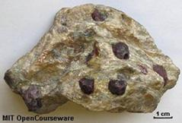
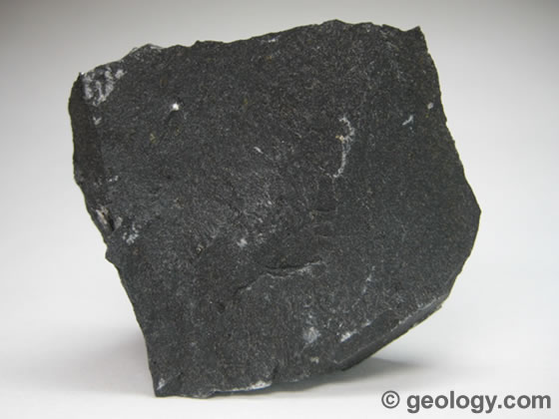

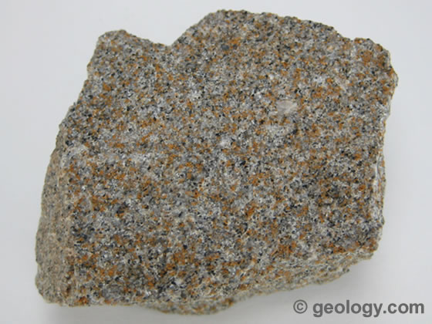
Physical condition of rock

Slide 7
Physical/Mechanical weathering:
Temperature:
As a result of diurnal temperature changes the rocks heated during day and cooled during night. Due to mono-mineralic and Poly-mineralic nature of rocks, a Differential expansion and contraction of minerals due to diurnal temperature changes resulting in peeling off the surface layers from rocks this process phenomenon is called ‘Exfoliation’ or Onion type weathering Ex: Basalt and Granite

Slide 8
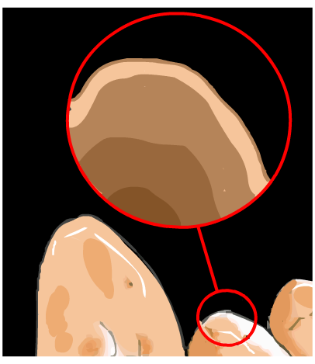
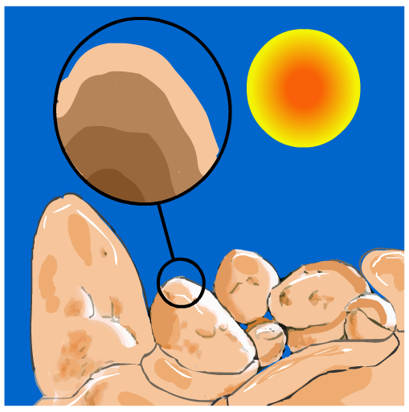
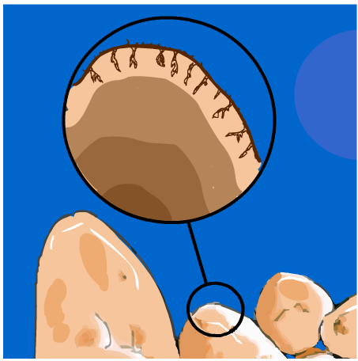
Temperature
3. As the rock keeps expanding and contracting, pieces of surface rock begin to flake and fall off.
1. During the day the sun heats up the surface of the rock causing the rock to expand.
2. During the night the rock cools down and contracts.

Slide 9
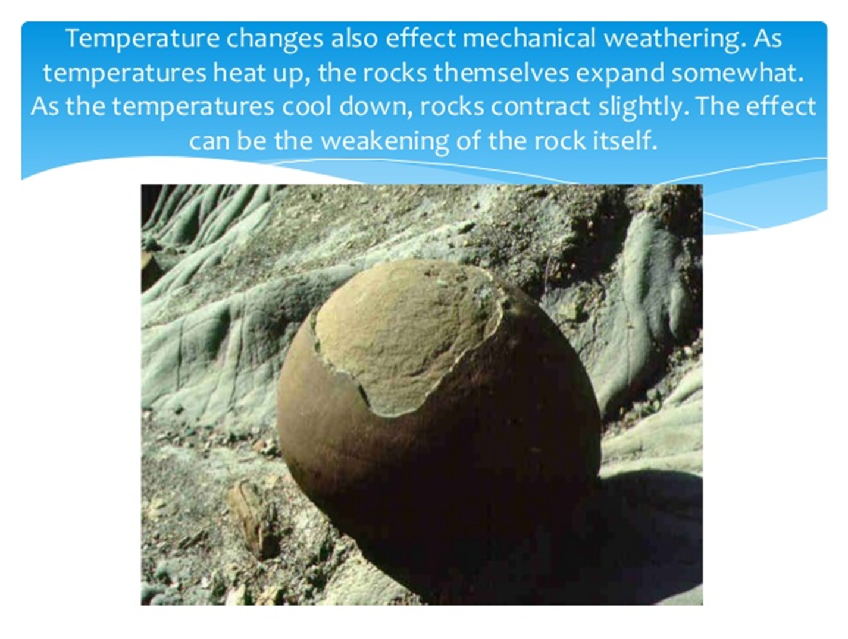

Slide 10

Repeated daily heating and cooling of rocks leads to split due to expansion and contraction of different minerals

Slide 11
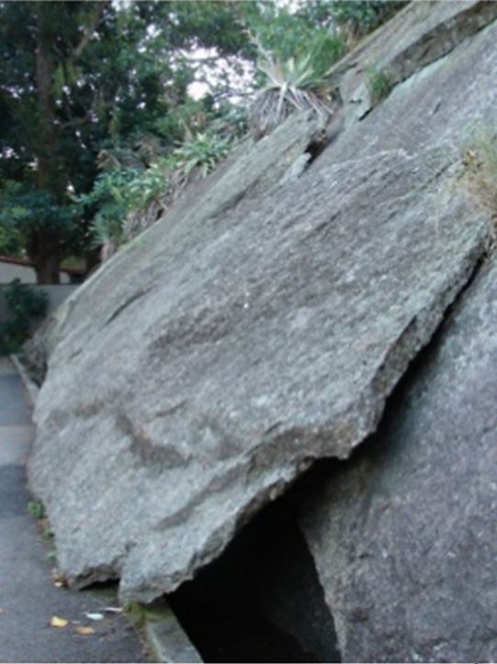
EXFOLIATION
Rock breaks off into sheets along joints which are parallel to the surface.
Caused by expansion of rock due to uplift and removal of surface material that originally buried the rock.

Slide 12
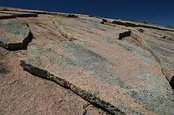
Exfoliated Granite Sheets.

Slide 13
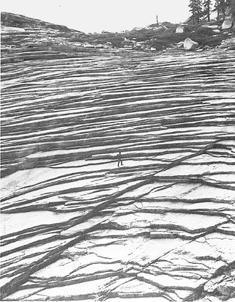
Sheet Joints (Exfoliation)

Slide 14
Physical/Mechanical weathering:
Cold Temperature:
Cold temperature causes the water in the cracks and crevices freezes in to ice, which increases the volume of water by 9 percent and exerts pressure of about 1465 tonnes/m², which leads to break down of rocks.

Slide 15
Physical/Mechanical weathering:
Water:
Most Pronounced weathering agent and it acts as disintegrating, transporting and depositing agent
Action of flowing water leads to collision of rocks, resulting in formation of smaller fragments which are transported and deposited at far off places
Sediment-loaded water has tremendous capacity to cut the rocks and hard surfaces, as a result gorges, ravines and valleys are formed

Slide 16
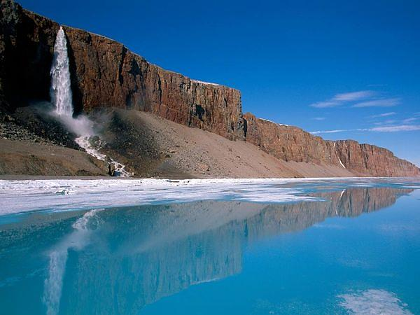
WATER

Slide 17
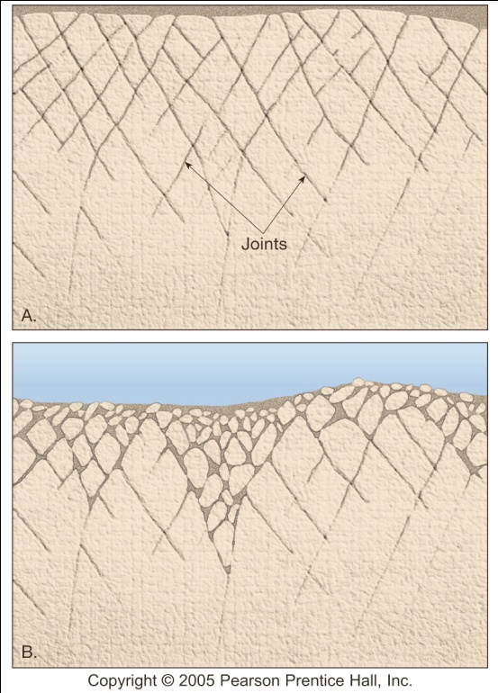
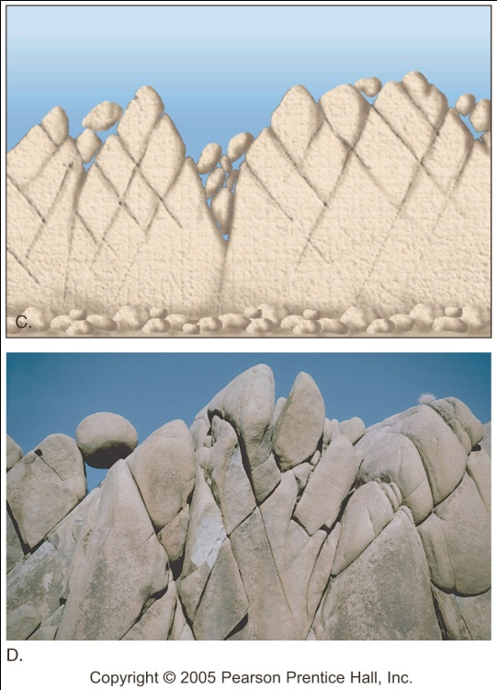
WATER
Joints in a rock are a pathway for water – they can enhance mechanical weathering

Slide 18
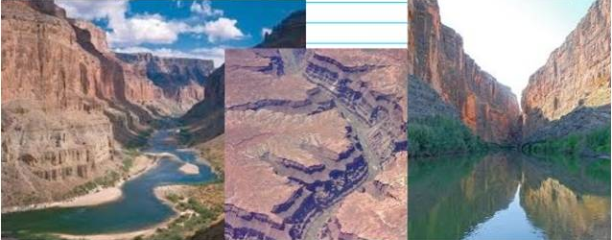

Slide 19
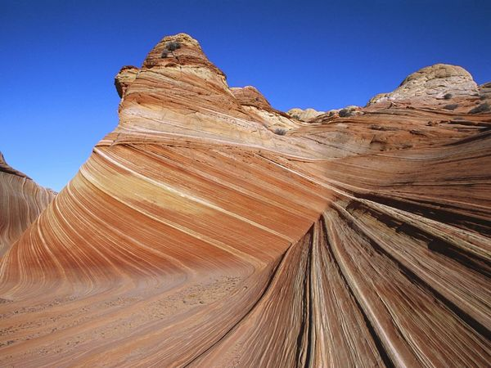
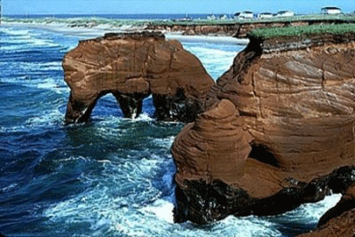

Slide 20
Physical/Mechanical weathering:
Water carries huge boulders which break into smaller
fragments due to continuous flowing in water with friction and/or abrasion.
Ice:
In colder regions, the moving Ice or glaciers cause
great deal of cutting and crushing of bed rocks. On
moving, Ice or glaciers exert a tremendous pressure on rock over which these pass.
The loose materials moves forward and gets deposited at lower reaches after melting of ice. This
deposit is called marine

Slide 21
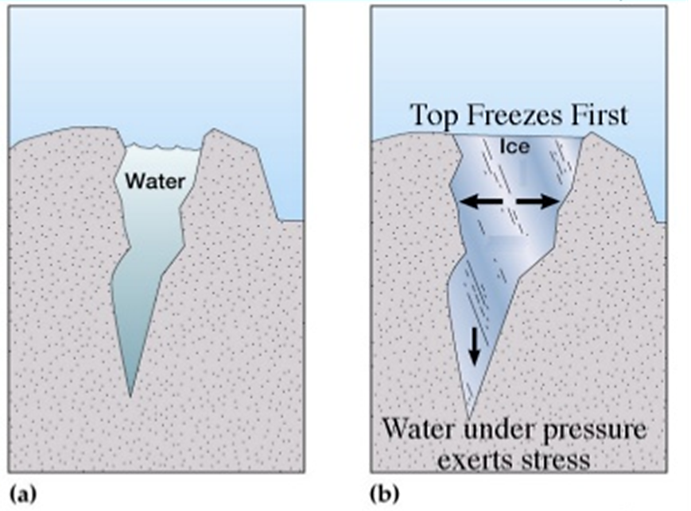
Ice wedging
Water seeps into cracks in rocks and freezes.
Water expands 10% when it freezes, pushing rock apart.
Repeated freeze and thaw cycles over the years causes rock to break.

Slide 22
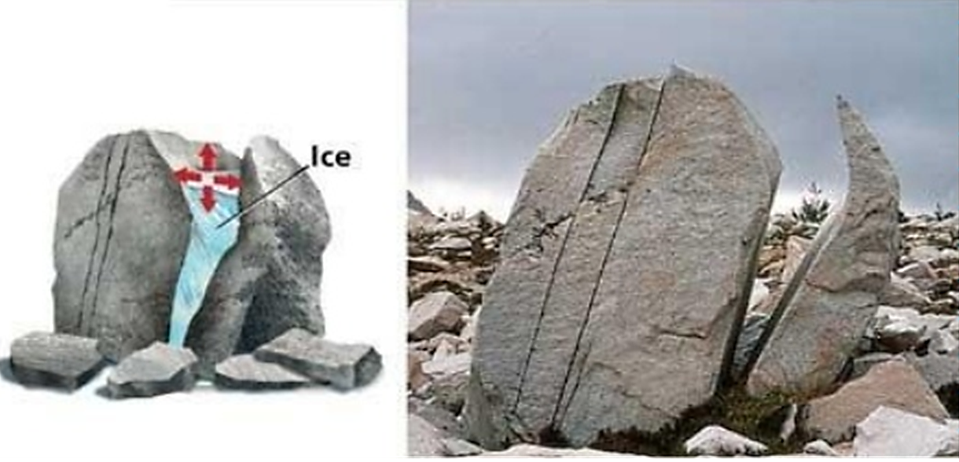
Ice wedging- Water seeps into cracks in rocks, freezes and expands and eventually cracks the rock

Slide 23
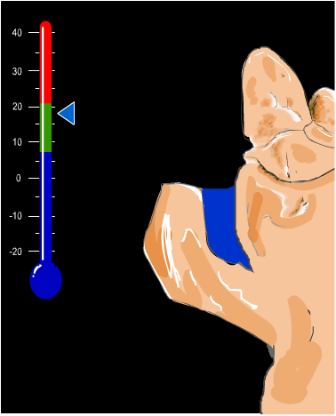
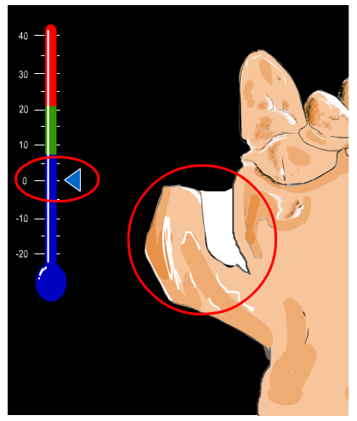
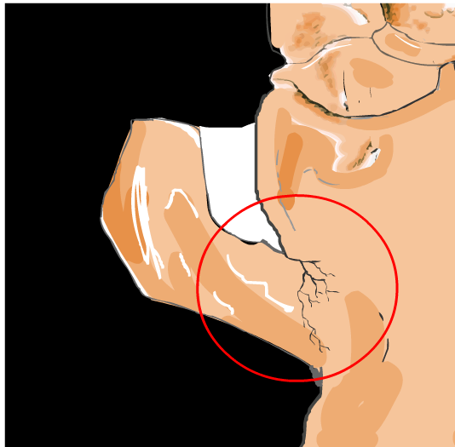
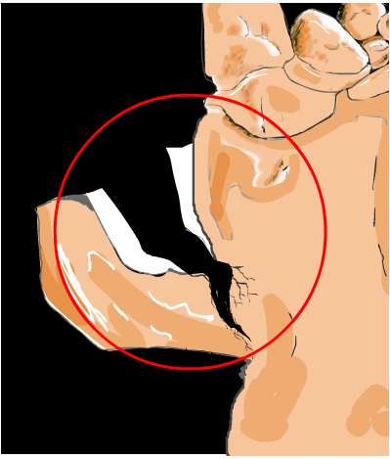

Slide 24
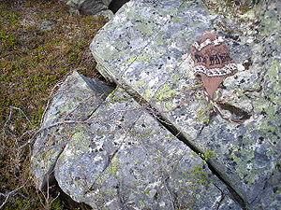
Frost weathering

Slide 25
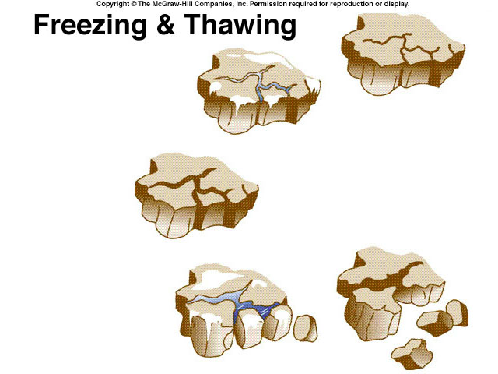

Slide 26
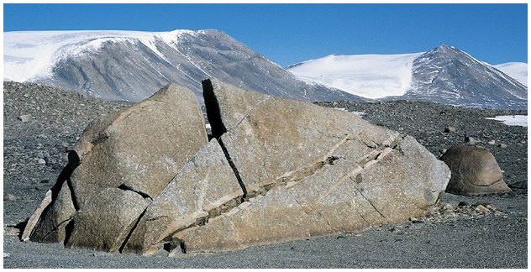
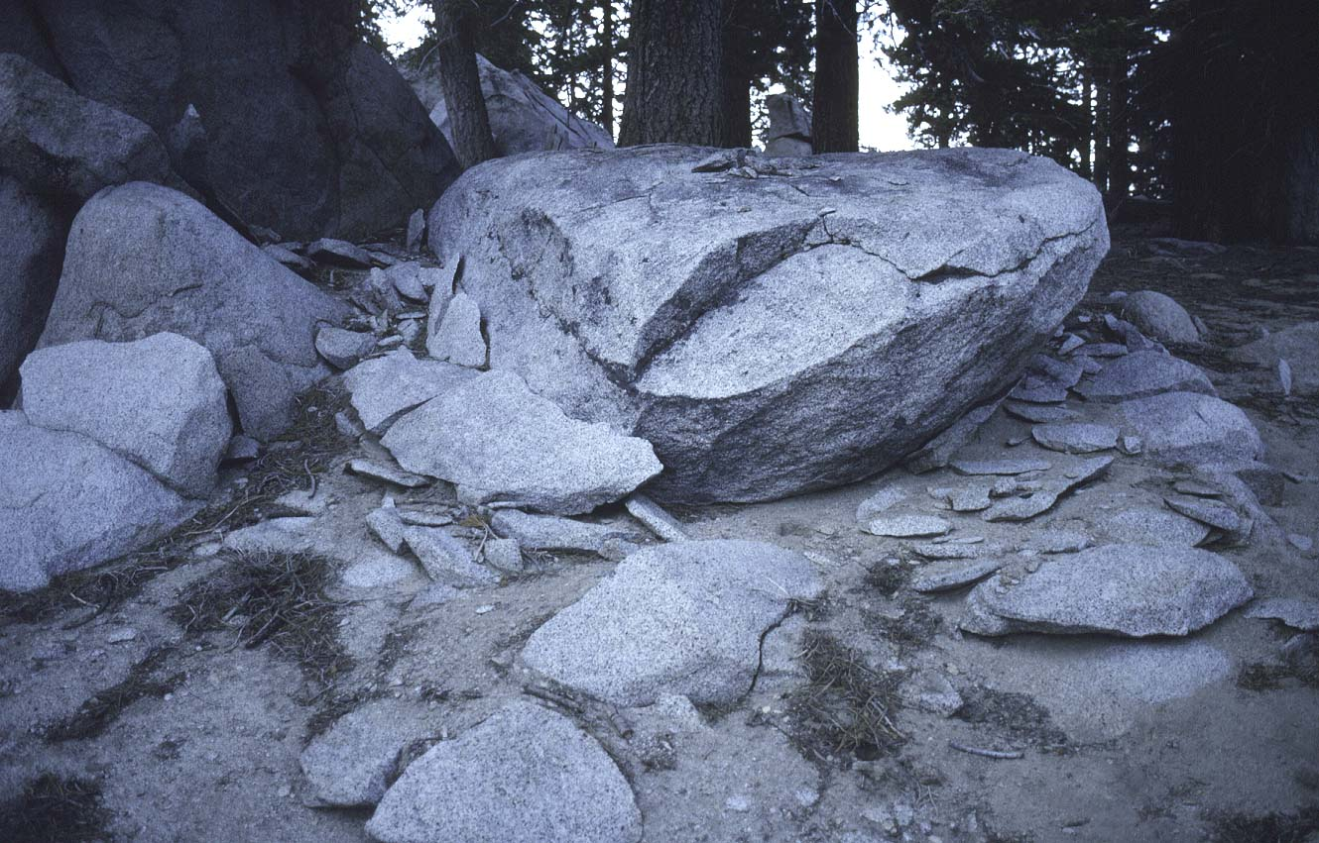
Shattered rocks are common in cold and alpine environments where repeated freeze-thaw cycles gradually force or split rocks apart.
Notes:
Effects of freeze thaw on granite. Mt. San Jacinto,southern California, Transverse Ranges. About 8,500 feet.

Slide 27
Physical/Mechanical weathering:
Wind:
Important agent of transportation of suspended particles
It also exert an abrasion effect which is more pronounced in the arid regions
The rounded rock Mushroom rock remnants in the Aravalis are caused by the wind erosion
Poorly grained or single grained deposits are more prone
Action of wind as weathering can be prominently seen in Thar Desert of Rajasthan

Slide 28
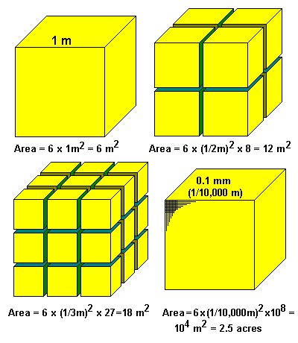
Surface Area and Weathering

Slide 29
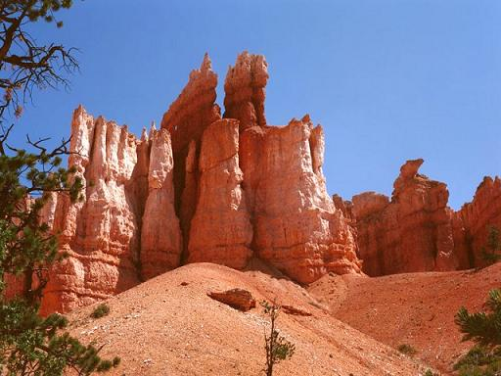
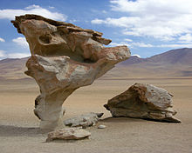
WIND

Slide 30
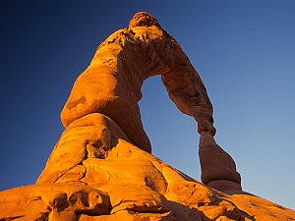
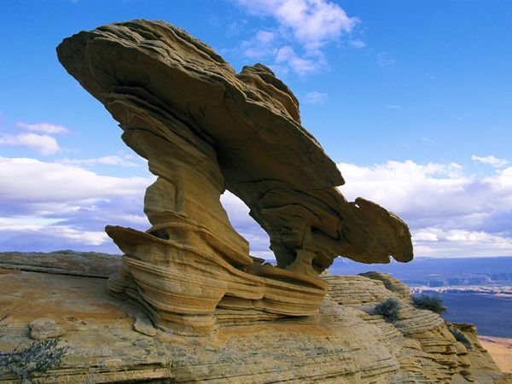

Slide 31
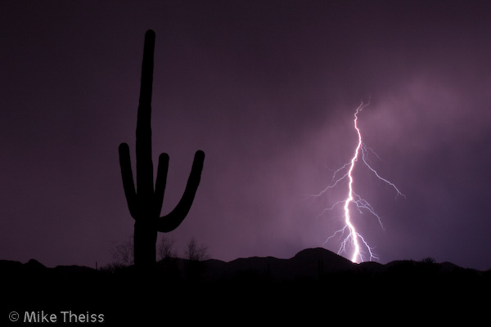
Atmospheric eclectic phenomenon

Slide 32
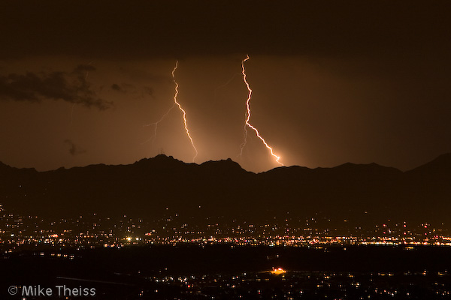

Slide 33
BIOLOGICAL WEATHERING
Is the Physical disintegration, and chemical decomposition of rocks and minerals by living agents.
Man, animals, higher plants, earth worms, termites and micro organisms are responsible for biological weathering
Organic activity from lichen and algae
Rock disintegration by plant growth
Burrowing and tunneling organisms
Secretion of acids

Slide 34
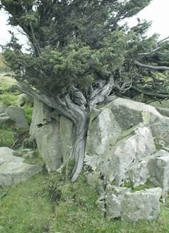
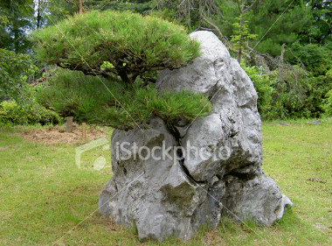

Slide 35
Flora
  The roots of the plants penetrate into small cracks of rocks. As they grow they exert disruptive force due to which even hard rocks break into pieces.
  Some roots grow deep in to soil and make open channels for percolation of water in to deeper layers.
  Roots produce acids (organic acids), which have solubilizing action of Minerals of rocks making them weak.
  The decomposition of organic matter due to microbial activity also produces several products which play a role in chemical weathering.

Slide 37
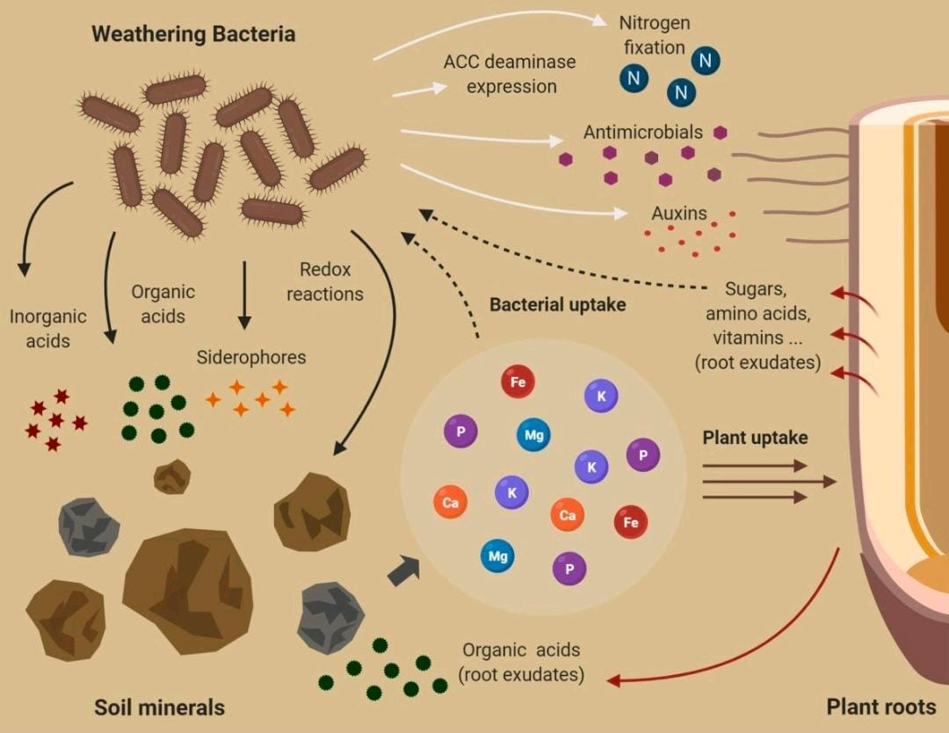

Slide 38
  The disintegration of rocks by cutting action of hills and rocks to build dams, roads, houses etc., by humans.
  The animals, insects live in rocks make burrows and holes in rocks leading to weakening of rocks.
  Ants and termites built galleries and passages and water percolate through the channels and galleries and help in weathering of materials in subsurface horizons. They secrete some acids like formic acid, which aid in decomposition of rocks
  .
Fauna

Slide 39
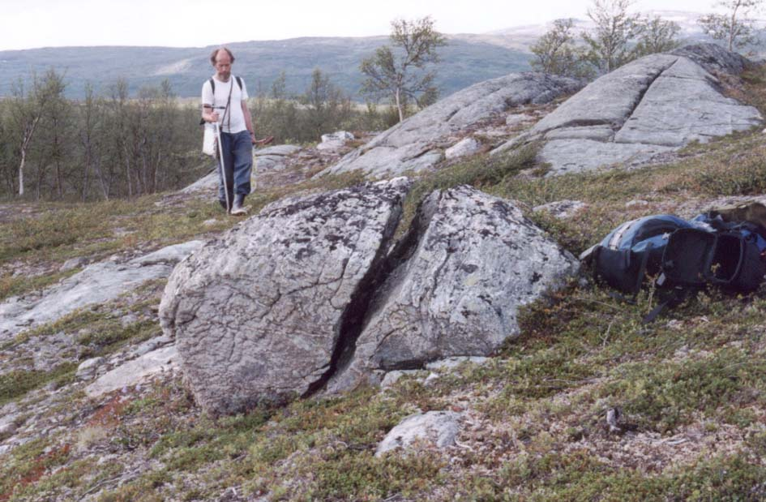

Slide 40
The physical, chemical and biological weathering processes occur simultaneously in nature.
Like wise different chemical weathering processes occur simultaneously and are interdependent.

Slide 41
Action of plants and animals:
  Lichens and mosses grow on rocks
    They wedge their tiny roots into spores and crevices.
    When the roots grow, the rock splits.

Slide 42
THANK YOU

